Slide 1

Project Work II
Unthinkable Solutions LLP
Presented by: Samriddhi Kakkar (EN18CS301225)

Slide 2
Contents
Project Plan to be Submitted
Introduction
Internship Profile
Understanding
the Project

Slide 3
Introduction
Unthinkable is a custom software development company specializing in designing, developing and scaling, beautiful products with high-speed efficiency. They can turn your ideas into innovative software applications faster and drive rapid business growth. Their proactive, professional, and cost-effective software development service delivery has included them amongst the best in the business. Unthinkable houses a team of 200+ developers catering to all the facets of software development. Be it Startups or Enterprises, SMEs or Governments, Product Companies or Digital Agencies, they cater to all of their diverse technology requirements. They build software solutions abiding by the traditional methodologies and develop products using decoupled software components to reduce redundant codes. Their domain knowledge, technology expertise, and the use of proven methodologies have yielded high-quality solutions that add value to your business. This has also allowed them to serve over 100 customers with a faster time to market. Their experience puts them in a position where they can take an unconventional approach to software development. This idea also led to the birth of the "Unthinkable". No of Employees: 1200+

Slide 4





Major Clients

Slide 5
Android
DevOps
LARAVEL
.Net
Flutter
React Native
ReactJS
NodeJS
Java
Technology Used by the Company

Slide 6
Internship Profile
As an intern, my role is of Junior Associate IT.
This internship commenced from 27th January 2022.
The technology assigned to me is DevOps.
We have interactive sessions on a regular basis to improve our soft skills.
We have been assigned as shadow resources in which we work under the guidance of our mentors.
After the shadow training we will be deployed to the live projects.

Slide 7
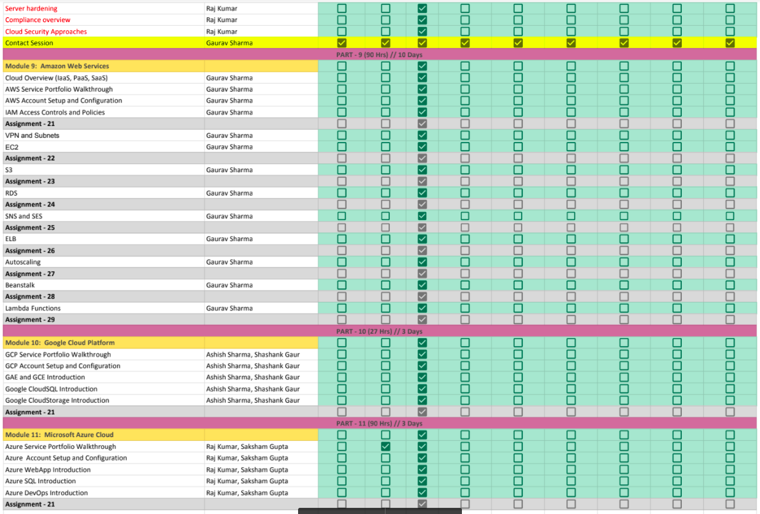
Project Plan to be Submitted

Slide 8
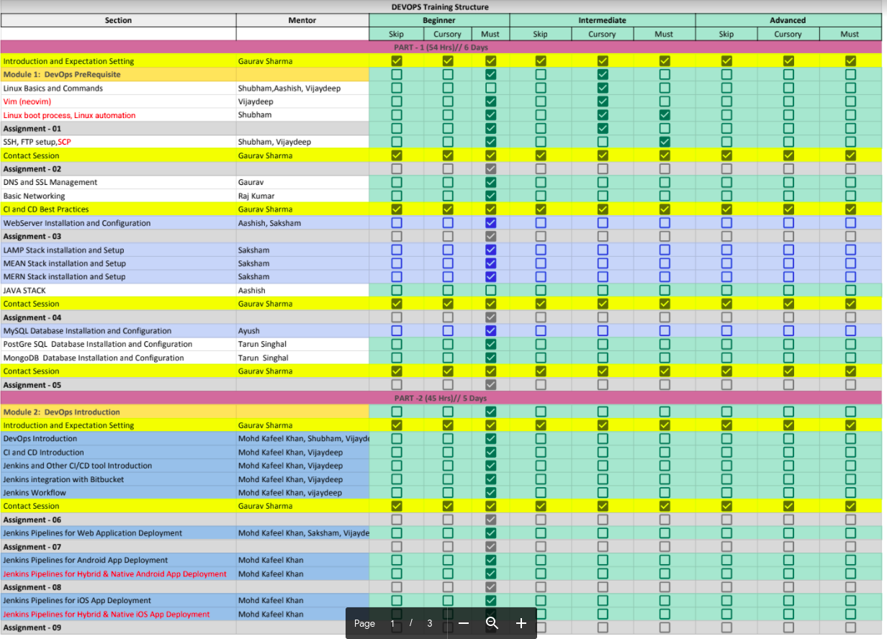
Project Plan to be Submitted

Slide 9
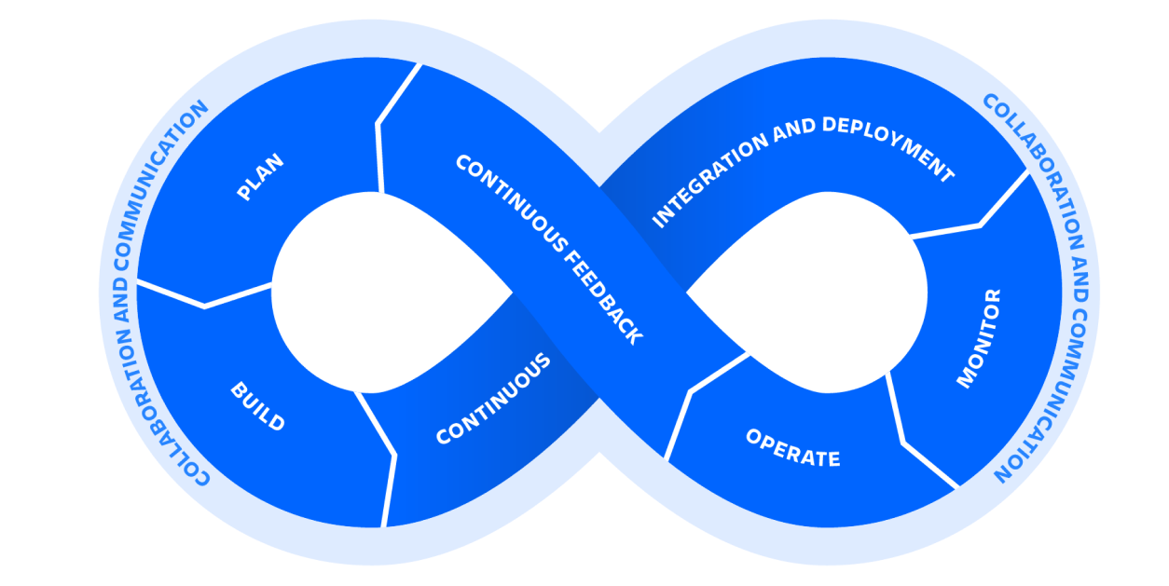
What is DevOps?
DevOps is a set of practices, tools, and a cultural philosophy that automate and integrate the processes between software development and IT teams. It emphasizes team empowerment, cross-team communication and collaboration, and technology automation.

Slide 10

What is AWS?
Amazon Web Services (AWS) is the world’s most comprehensive and broadly adopted cloud platform, offering over 200 fully featured services from data centers globally. Millions of customers—including the fastest-growing startups, largest enterprises, and leading government agencies—are using AWS to lower costs, become more agile, and innovate faster.

Slide 11
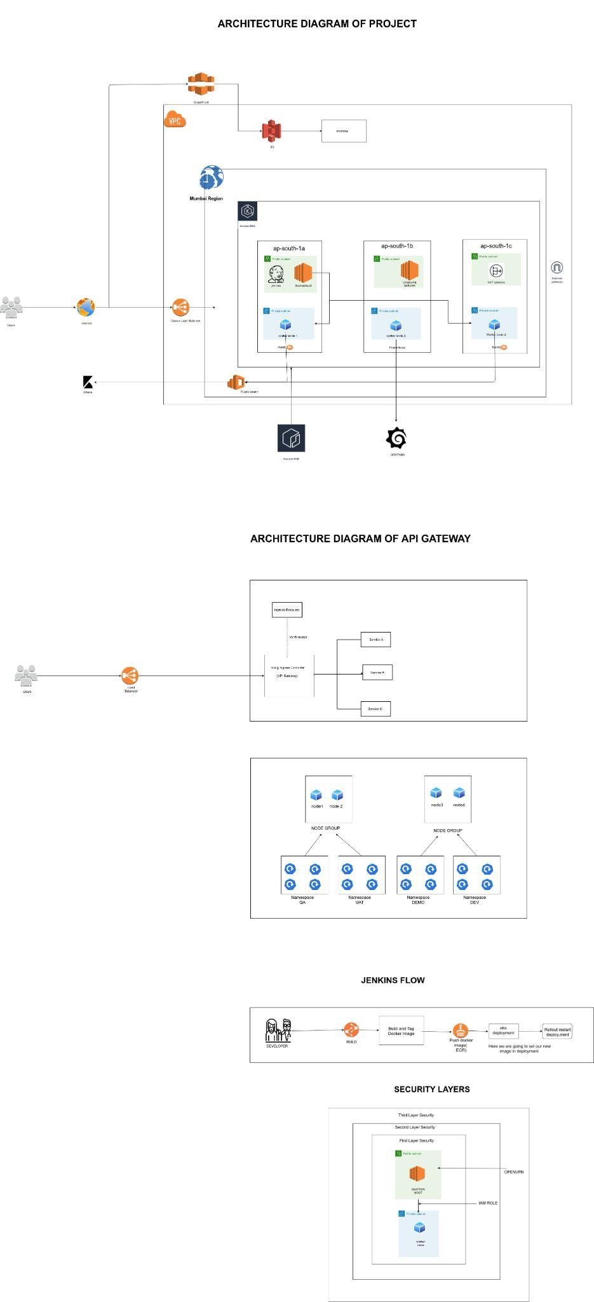
Project Architecture Diagram

Slide 12
Virtual Private Clouds
Amazon Virtual Private Cloud (Amazon VPC) enables you to launch AWS resources into a virtual network that you've defined. This virtual network closely resembles a traditional network that you'd operate in your own data center, with the benefits of using the scalable infrastructure of AWS
Amazon VPC enables you to build a virtual network in the AWS cloud - no VPNs, hardware, or physical data centers required. You can define your own network space, and control how your network and the Amazon EC2 resources inside your network are exposed to the Internet.

Slide 13
Elastic Compute Clouds Instances (EC2)
Amazon EC2 (Elastic Compute Cloud) is a web service interface that provides resizable compute capacity in the AWS cloud. It is designed for developers to have complete control over web-scaling and computing resources.
Amazon Elastic Compute Cloud (Amazon EC2) offers the broadest and deepest compute platform, with over 500 instances and choice of the latest processor, storage, networking, operating system, and purchase model to help you best match the needs of your workload

Slide 14
Subnets : Private & Public
A subnet, or subnetwork, is a segmented piece of a larger network. More specifically, subnets are a logical partition of an IP network into multiple, smaller network segments. The Internet Protocol (IP) is the method for sending data from one computer to another over the internet.
For example, the prefix 198.51. 100.0/24 would have the subnet mask 255.255. 255.0. Traffic is exchanged between subnetworks through routers when the routing prefixes of the source address and the destination address differ.

Slide 15
Route Tables
In computer networking, a routing table, or routing information base, is a data table stored in a router or a network host that lists the routes to particular network destinations, and in some cases, metrics associated with those routes.
A routing table is a set of rules, often viewed in table format, that is used to determine where data packets traveling over an Internet Protocol (IP) network will be directed. All IP-enabled devices, including routers and switches, use routing tables.

Slide 16
Internet Gateway
An internet gateway enables resources (like EC2 instances) in your public subnets to connect to the internet if the resource has a public IPv4 address or an IPv6 address. Similarly, resources on the internet can initiate a connection to resources in your subnet using the public IPv4 address or IPv6 address.
An Internet gateway is a network "node" that connects two different networks that use different protocols (rules) for communicating. In the most basic terms, an Internet gateway is where data stops on its way to or from other networks. Thanks to gateways, we can communicate and send data back and forth with each other.

Slide 17
NAT Gateway
NAT Gateway isÂ a highly available AWS managed service that makes it easy to connect to the Internet from instances within a private subnet in an Amazon Virtual Private Cloud (Amazon VPC). Previously, you needed to launch a NAT instance to enable NAT for instances in a private subnet
You only need a NAT Gateway if your Lambda function will be accessing the internet. Assuming that you do need a NAT, you can just use one NAT Gateway for all your private subnets. All your public subnets must route to an Internet Gateway for non-local addresses.An internet gateway serves two purposes: to provide a target in your VPC route tables for internet-routable traffic, and to perform network address translation (NAT) for instances that have been assigned public IPv4 addresses.

Slide 18
Elastic Load Balancer
Elastic Load Balancing (ELB) automatically distributes incoming application traffic across multiple targets and virtual appliances in one or more Availability Zones (Azs).
AWS offers three types of load balancers, adapted for various scenarios: Elastic Load Balancers, Application Load Balancers, and Network Load Balancers.A load balancer is a device that acts as a reverse proxy and distributes network or application traffic across a number of servers. Load balancers are used to increase capacity (concurrent users) and reliability of applications.
Load balancing is used to divvy up between two or more servers the amount of work usually done by one, allowing more work to get done in the same amount of time. In general, this means that all users are served faster. Load balancing can be implemented with hardware, software, or a combination of both.

Slide 19
Elastic Kubernetes Service (EKS)
Amazon Elastic Container Service for Kubernetes (Amazon EKS) is a managed service that makes it easy for users to run Kubernetes on AWS without needing to stand up or maintain your own Kubernetes control plane. Since Amazon EKS is a managed service it handles tasks such as provisioning, upgrades, and patching.
Definition aside, let’s take a look at the benefits of Amazon EKS:
➔ Amazon EKS runs the Kubernetes management infrastructure across multiple AWS Availability Zones, thereby freeing users from maintaining Kubernetes control planes.
➔ Infrastructure running on Amazon EKS is secure by default by setting up a secure and encrypted communication channel between worker nodes & Kubernetes endpoint.
➔ AWS actively works with the Kubernetes community and makes contributions to the Kubernetes code base.
➔ Applications managed by Amazon EKS are fully compatible with applications managed by any standard Kubernetes environment.

Slide 20
Jenkins
Jenkins is an open-source automation tool written in Java with plugins built for Continuous Integration purposes. Jenkins is used to build and test your software projects continuously making it easier for developers to integrate changes to the project, and making it easier for users to obtain a fresh build. It also allows you to continuously deliver your software by integrating with a large number of testing and deployment technologies.
With Jenkins, organizations can accelerate the software development process through
automation. Jenkins integrates development life-cycle processes of all kinds, including
build, document, test, package, stage, deploy, static analysis, and much more.
Jenkins achieves Continuous Integration with the help of plugins. Plugins allow the
integration of Various DevOps stages. If you want to integrate a particular tool, you need to
install the plugins for that tool. For example Git, Maven 2 project, Amazon EC2, HTML
publisher etc.

Slide 21
Prometheus/Grafana
Prometheus works well for recording any purely numeric time series. It fits both
machine-centric monitoring as well as monitoring of highly dynamic service-oriented
architectures. In a world of microservices, its support for multi-dimensional data collection
and querying is a particular strength.
Grafana is an open source solution for running data analytics, pulling up metrics that make
sense of the massive amount of data & to monitor our apps with the help of cool
customizable dashboards. Grafana connects with every possible data source, commonly
referred to as databases such as Graphite, Prometheus, Influxdb, ElasticSearch, MySQL,
PostgreSQL etc.

Slide 22
Thank You

